Slide 1
Run the Rich Mirror Alignment
Claire Prouve
Also look here: https://twiki.cern.ch/twiki/bin/view/LHCb/LHCbRichMirrorAlignRunOnline

Slide 2
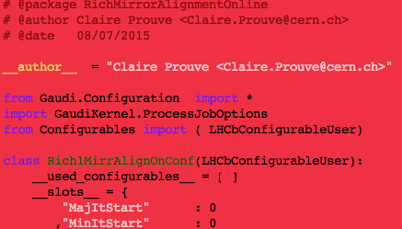

Configuration file (1/2)
Location: /group/rich/sw/cmtuser/AlignmentOnlineDev_v10r6/Rich/RichMirrorAlignmentOnline/python/RichMirrorAlignmentOnline/Configuration.py
1. Rich1MirrAlignOnConf
…
2. Rich2MirrAlignOnConf
…

Slide 3
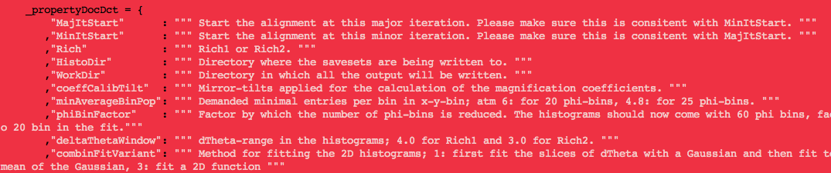
Configuration file (2/2)
Configuration-variables explained below the listing:
After a change: compile!
cd /group/rich/sw/cmtuser/AlignmentOnlineDev_v10r6
export OnlineDev_DIR=/group/online/dataflow/cmtuser/OnlineDev_v5r29/InstallArea/$CMTOPT
make –j 8 install
Or the corresponding version of OnlineDev listed in /group/rich/sw/cmtuser/AlignmentOnlineDev_v10r6/CMakeLists.txt

Slide 4
XML-file to start from
XML-file taken from: /group/online/alignment/Rich1/MirrorAlign/ /group/online/alignment/Rich2/MirrorAlign/
Iterator picks the one with the biggest version number.
According to other sub-detectors the above folders should only contain the files that made it into the CONDDB.
Run with your XML-file of choice:
Copy it into the corresponding folder with a big version number
Delete it after you are done
(maybe I’ll program something better soon, will let you know.)
The xml files should not have a header. If you add your own xml-file to the list remove the header (= the first three lines; and the little </DDB> at the end).

Slide 5
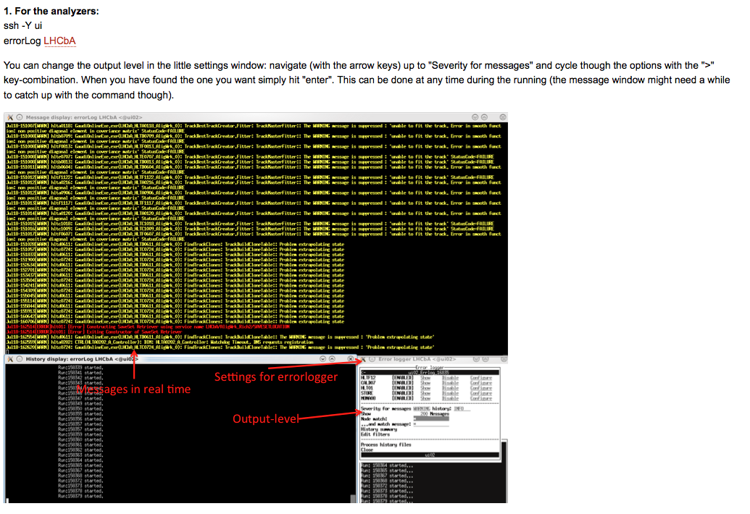
Start the error loggers

Slide 6
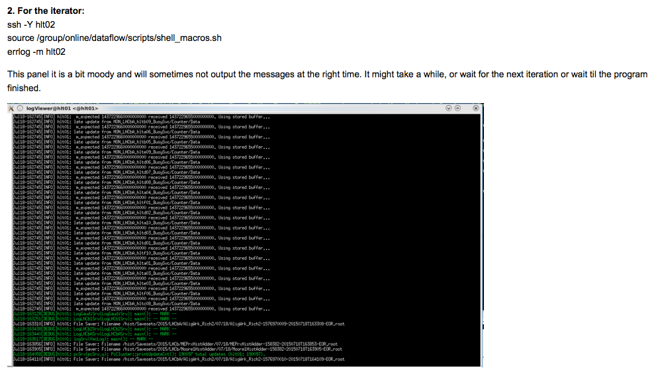
Start the error loggers

Slide 7
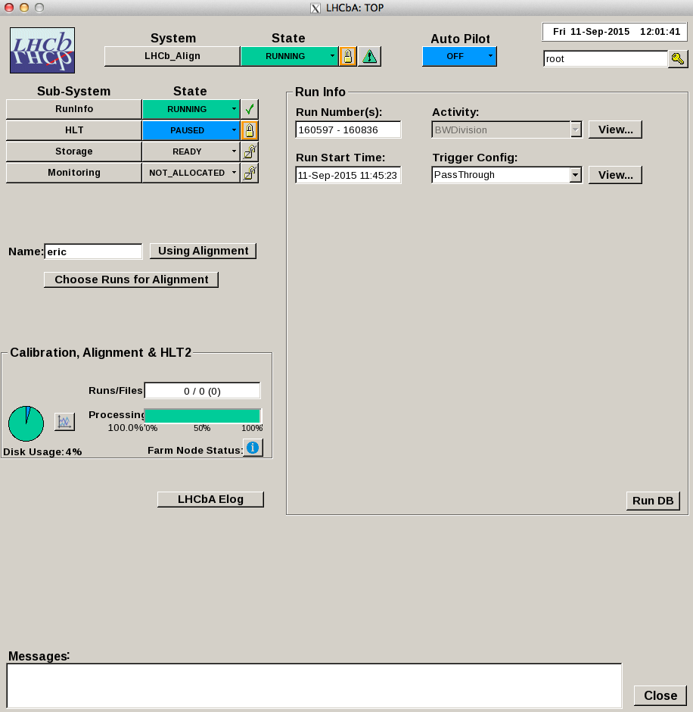
Start the runcontrol panel
1. Log into ui machine: ssh -Y ui
2. Start the panel : /group/online/ecs/Shortcuts311/LHCb/ECS/ECS_UI_FSM.sh
3. Right-click on LHCb_Align
This is what it looks like: (approximately, it may change over time)

Slide 8
Take the partition (optional)
Take the partition
If this panel is “unclickable” you have to take the partition.
If it is clickable don’t take the partition.
Click "take" and then wait for a smaller new panel to show up (this may take a while, just be patient). In the new panel just click "dismiss".

Slide 9
Reserve the farm
Type your name in and click the “Using Alignment” button.
Reserve the farm

Slide 10
Chose alignment
Pick alignment

Slide 11
Allocate
Select “Allocate” in the menu and wait until the partition is allocated.
Allocate

Slide 12
Chose runs for alignment (1/2)
Choose runs

Slide 13
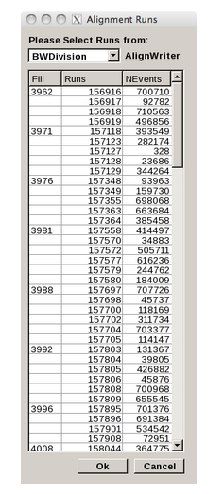
Chose runs for alignment (2/2)
This is by default the alignment you are running.
Select your runs.
Nevents is the number for RICH1 + RICH2 (because we only have one HLT1 line for both). There should be about 50% RICH1 events and 50% RICH2 events.
Click “Ok”.

Slide 14
Run the alignment (1/2)
Configure the alignment.
The configuring process might take a couple of minutes and some nodes might take significantly longer than others. That's just normal.
There is a time-limit set of how long the configureing is allowed to take. It is possible to take longer and if nodes take longer their status will appear as error. Give it time and verify in the errorlogger that something is still happening.
Configure

Slide 15
Run the alignment (2/2)
When the configuring is done select “start run”.
If the autopilot is on it will start automatically.
When the alignment has finished the state will go to “READY”. If that happens, before touching anything else, check the output files if alignment has really converged. Otherwise click “start run” again.
Start run

Slide 16
Free the farm
Click the “Free” button.
Reserve the farm

Slide 17
Verify and trouble shoot

Slide 18
The HLT farm and its nodes
To look at the state of the farm and the individual nodes click the HLT button and wait for a new window to appear.

Slide 19
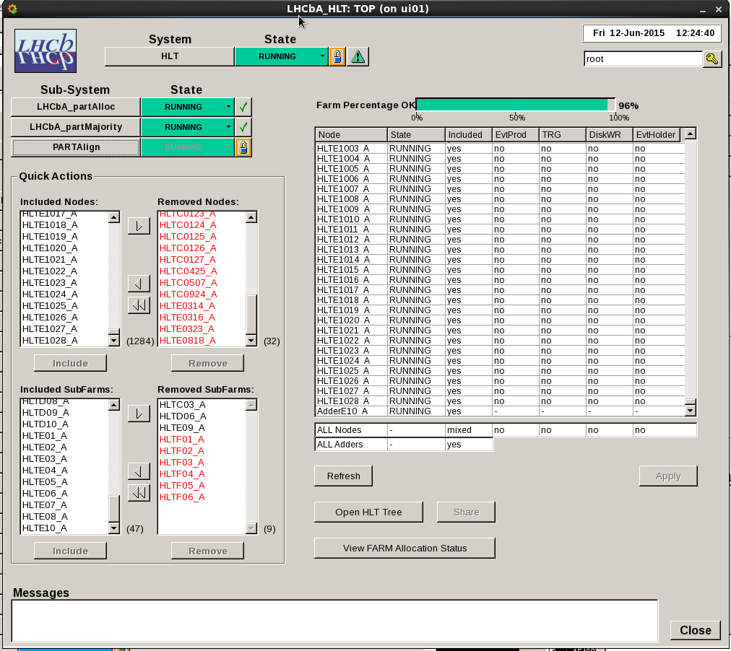
The HLT farm and its nodes
Shows included/excluded nodes and farms.
If number of included nodes <<1700: deallocate and reallocate.
Exclude nodes (not subfarms): 1. select the node (e.g. HLTE1028_A) 2. click “arrow” to exclude area
3. Click “remove” to exclude (might take a while, just wait)
Move selected nodes to exclude
Number of included nodes
Exclude
Included subfarms

Slide 20
State of farms and nodes
To look at the state of the farm and the individual nodes click the “PartAlign” button and wait for a new window to appear.
Alignment partition

Slide 21
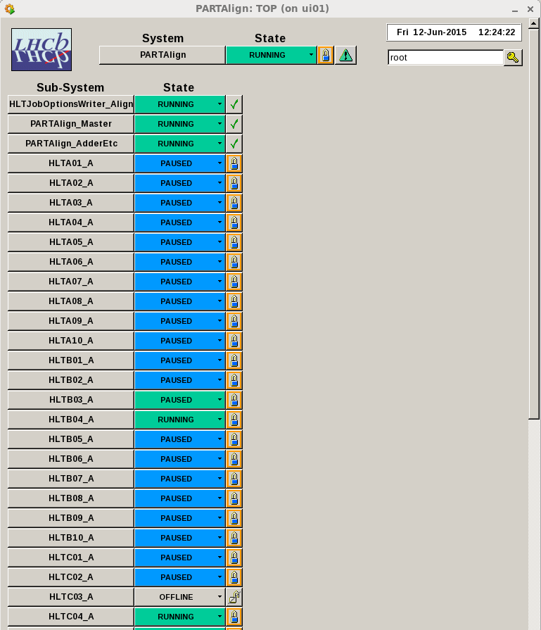
State of farms and nodes
Click on a farm to see its individual nodes.
Iterator
Subfarms

Slide 22
Output of the alignment
During the alignment procedure the files are stored in:
/group/online/AligWork/Rich1
/group/online/AligWork/Rich2
After the alignment has finished the alignment is copied under a time-stamp to:
/group/online/AligWork/MirrorAlignments/Rich1
/group/online/AligWork/MirrorAlignments/Rich2
Sometimes a copy is made in the middle of the alignment procedure (just ignore for now).
Make logbook entry. ☺

Slide 23
Stuff that happens
Everything takes ages: that’s normal :D
Farms goes into state error: Check weather it is all nodes or just one
If its all nodes then there is an actual error in the code, try checking the error loggers.
If only individual nodes are in error it could be time-out during configuring (give it time ~20 min, see slide 14), or a crushed node during running (exclude the node as shown in slide 19 and start run again).
Alignment goes into state “READY” but the alignment hasn’t converged: just click on “start run” again (no reconfiguring etc.!!!) as in slide 15
Read herring in errorlogger: something complaining about some Configuration.py file in the “OnlineDev …” directory ➔ something in our own Configuration file is wrong

